Slide 1


Arduino-based real-time air quality and pollution monitoring system
Patel Harshkumar (harshkumar.patel@stud.fra-uas.de)
Patel Parthkumar (parth.patel@stud.fra-uas.de)
Prajapati Riddhi (riddhi.prajapati@stud.fra-uas.de)

Slide 2
Agenda
Abstract
Introduction
Equipment discussion
Block Diagrams
Time Plan
Team Organization
Circuit
Implementation

Slide 3
Abstract
In this study, air quality were measured using MQ135 sensor, respectively.
Measurement of air quality is a crucial step in raising public awareness of the need to ensure the health of future generations.
Due to the recent rapid industrialization, there is an enormously growing need for individuals to monitor their local air quality in order to understand how they live and what they breathe.
In this work, we suggested an Arduino-based real-time air quality and pollution monitoring system.
This environmental air monitoring system is made to offer a reliable, simple, and effective way to continually and in-the-moment check the air quality.
Notes:
-I would like to present our implementation study. So basically air quality is a common problem in our lives.
-The measurement of air quality is an important part of public awareness.
-People nowadays more than ever need to analyze their local air quality in order to understand how they live and what they breathe because of how quickly industrial has been progressed.
-so here, In this study, we suggested a real-time air quality and pollution monitoring system built on an Olimexino platform. For air quality measures, we are using MQ135 sensor.
- An air monitoring system is designed to provide a safe, useful, and effective solution to continuously and quickly assess of the air quality.

Slide 4
Introduction
The production of harmful gases by companies, automobile emissions, and an increase in the amount of harmful chemicals and particulate matter in the atmosphere are all contributing to air pollution.
Due to factors that can harm human health, such as industries, urbanization, population growth, and automobile use, the level of pollution is increasing rapidly.
One of the most crucial factors contributing significantly to the rise in air pollution is particulate matter.
This requires the measurement and analysis of real-time air quality monitoring in order to allow for prompt decision-making.
An objective real-time air quality monitoring system is discussed in this work.
Notes:
Introduction-Air pollution is caused by a variety of factors, including the release of dangerous gases by industry, the pollution of cars, and a rise in the amount of harmful chemicals and particle pollution in the atmosphere.
-Levels of pollution are rapidly growing due to causes that can harm human health, such as industry, urbanization, increased population, and transportation use.
-Dust particles is one of the most important causes for the increase in air pollution. We can find the amount of dust particles through the circuit implementation, For this implementation we used Olimexino, Bread board, (MQ135 as a air quality & Gas sensor), Dust sensor, Humidity sensor as a temperature sensor and LCD screen for the output.

Slide 5
Equipment
Arduino Uno (Olimexino)
Breadboard
MQ-135 (Air Quality and Hazardous Gas Sensor)
Temperature Sensor
Humidity Sensor
Dust Sensor
LCD
Notes:
These all the equipments which is we used in our system.

Slide 6
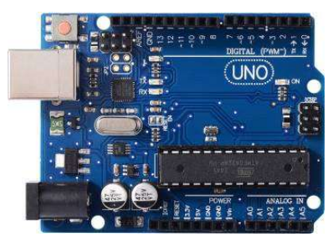
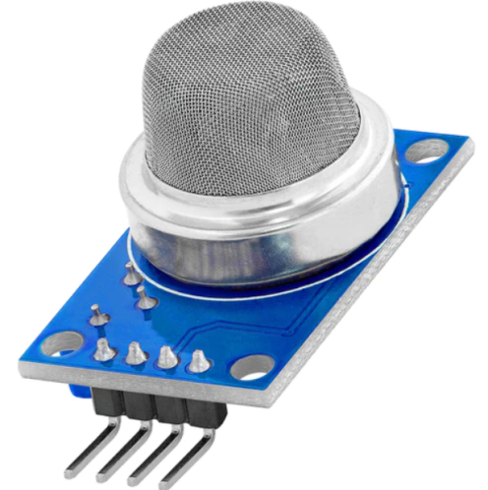
Equipment Description
A) ARDUINO UNO (Olimexino) BOARD
The microcontroller Arduino can work with a number of different sensors.
The board can be used with the greatest amount of effectiveness due to its simplicity and accessibility of a number of equipment extensions.
B) MQ-135 (Air Quality and Hazardous Gas Sensor)
Ammonia, benzene, nitric oxide, smoke gases, argon gases, and many other gases are among the wide spectrum of chemicals that MQ135 is used to detect, making it possible to use this system both indoors and outdoors.
In addition to being highly sensitive to smoke and other dangerous gases, it is also highly sensitive to ammonia, nitric oxide, and benzene steam.
Notes:
-I would like to present First equipment Arduino or Olimexino. We use here Olimaxino which is work as Arduino uno
this microcontroller can interface with a number of sensors.
-This board can be used with the greatest amount of effectiveness due to its flexibility and accessibility
as the no of equipment partials.
Next one is Mq 135 which contains air quality sensor and gas detect sensor
-this sensor will detect a wide range of chemicals, including ammonia, benzene, nitric oxide, smoke gases, and many more.
As u can see in our implementation, It is indicated by the poor, very bad, and good air quality as an output.

Slide 7
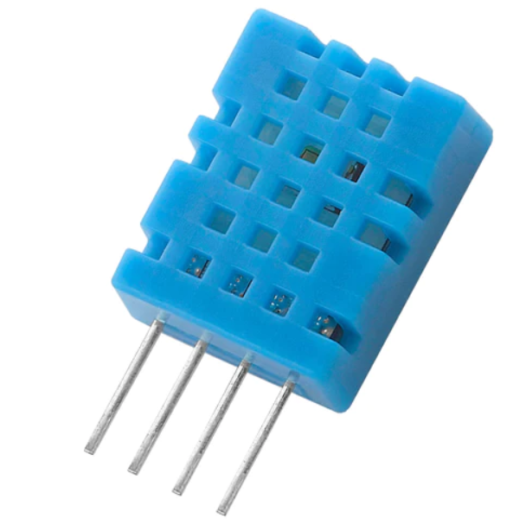
C) Temperature Sensor
In task mechanization, temperature is the procedure variable that is most frequently measured.
The important instrument for monitoring temperatures in industrial systems is temperature sensors.
D) Humidity Sensor
A humidity sensor is a device that calculates the relative humidity in a specific area.
Humidity sensors come in analog and digital varieties.
Notes:
The third one is temperature sensor & humidity sensor both will work as which is utilized indoor and outdoors too.. this sensor indicates the temperature of monitoring important instrument or device in industrial systems. These both sensor work equally. It shown a device that calculates the relative humidity in specific area. Which is indicate in analogue and digital varieties.

Slide 8
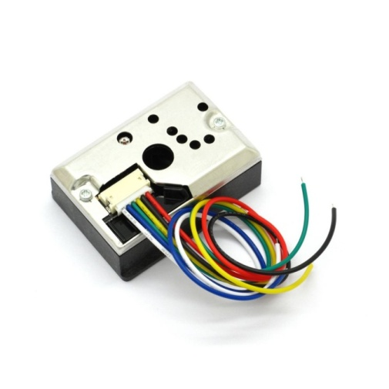
E) Dust Sensor
It is used to identify the little particles in the air that will eventually cause larger contaminations.
It is nowhere close to being capable of detecting the best molecules that are larger than 0.8μm, much like cigarette smoke.
Notes:
The fourth one is dust sensor, It is used to identify small particles in the air that can eventually cause huge pollutions.
Such as micro size water droplet, like fog and mist, as particles.

Slide 9
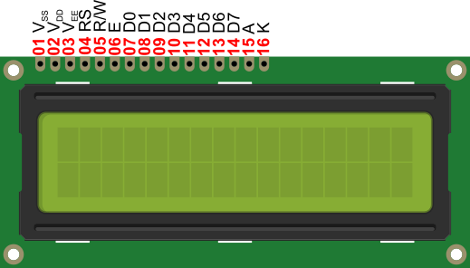
F) LCD Display
Liquid cell shows (LCDs) accustomed show of display of numeric and alphanumeric characters in matrix and segmental displays.
The parallel interface of LCDs require simultaneous control of many interface pins by the microcontroller in order to control the display. The intrface consists of the following pins:
A register (RS) pin that controls where data is written to the LCD's memory.
The Read/Write (R/W) pin, that chooses between reading and writing mode.
An Enable pin - enables writing to the registers.
8 Data pins.
Notes:
LCD display - we used 16*2 LCD screen.
It shows numeric and alphanumeric charaters in matrix and segmental displays
It indicate RS which is a register, R/W for read and write mode, and Enables. & the display contains 8 digit data in single panel.

Slide 10
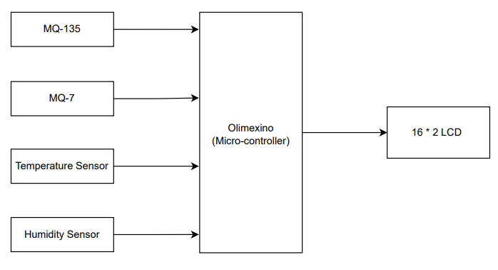
Block Diagrams
Dust Sensor
Notes:
This is our system’s block diagrams
The Mq 135, dust sensor, temperature sensor or humidity sensor, these all equipment's are connected with the Olimexino and the LCD shows u the output of the system.

Slide 11
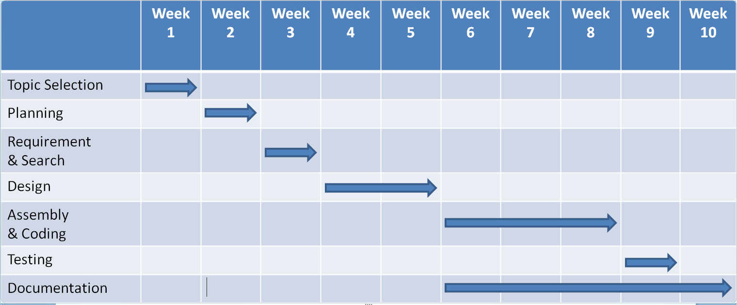
Time Plan
Notes:
This is time plan of our project.

Slide 12
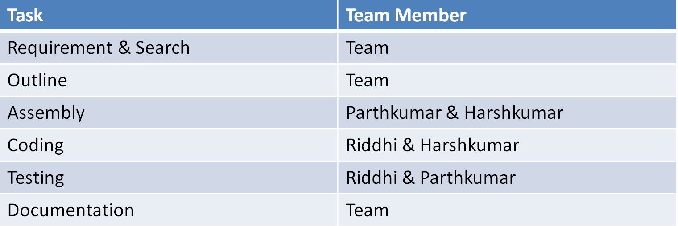
Team Organization
Notes:
And these are the all task of our project that I performed with my teammates.

Slide 13
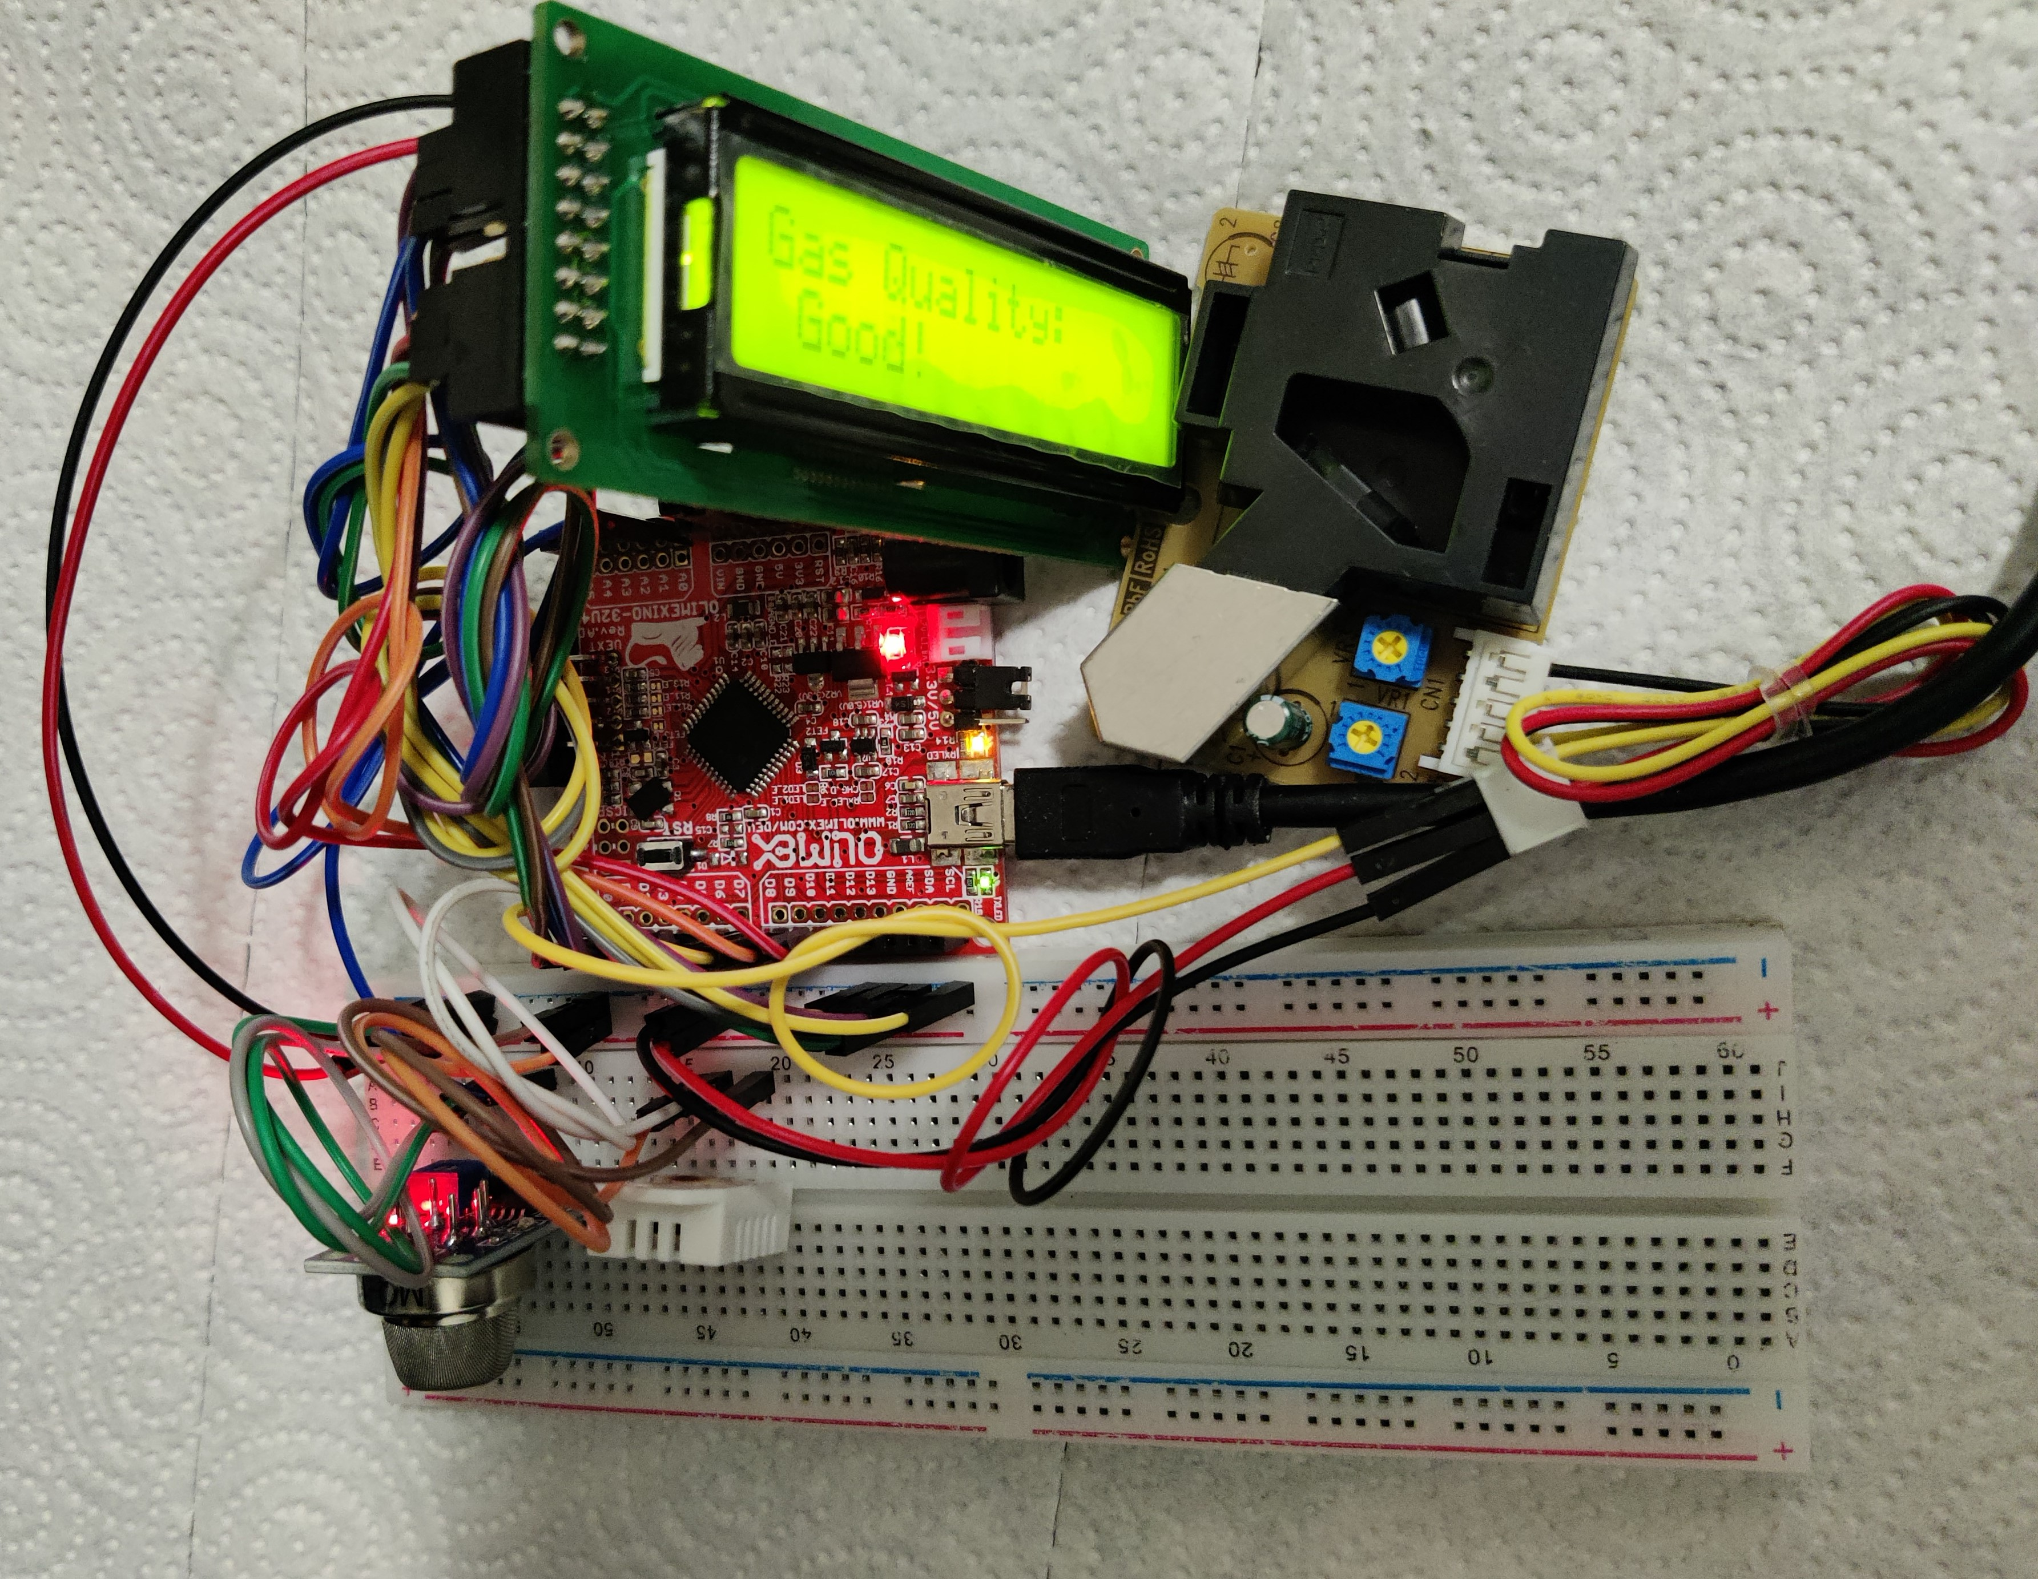
Circuit
Notes:
this is the circuit of our project. As you can shown in picture the all the equipment’s are interconnected with each other.

Slide 14
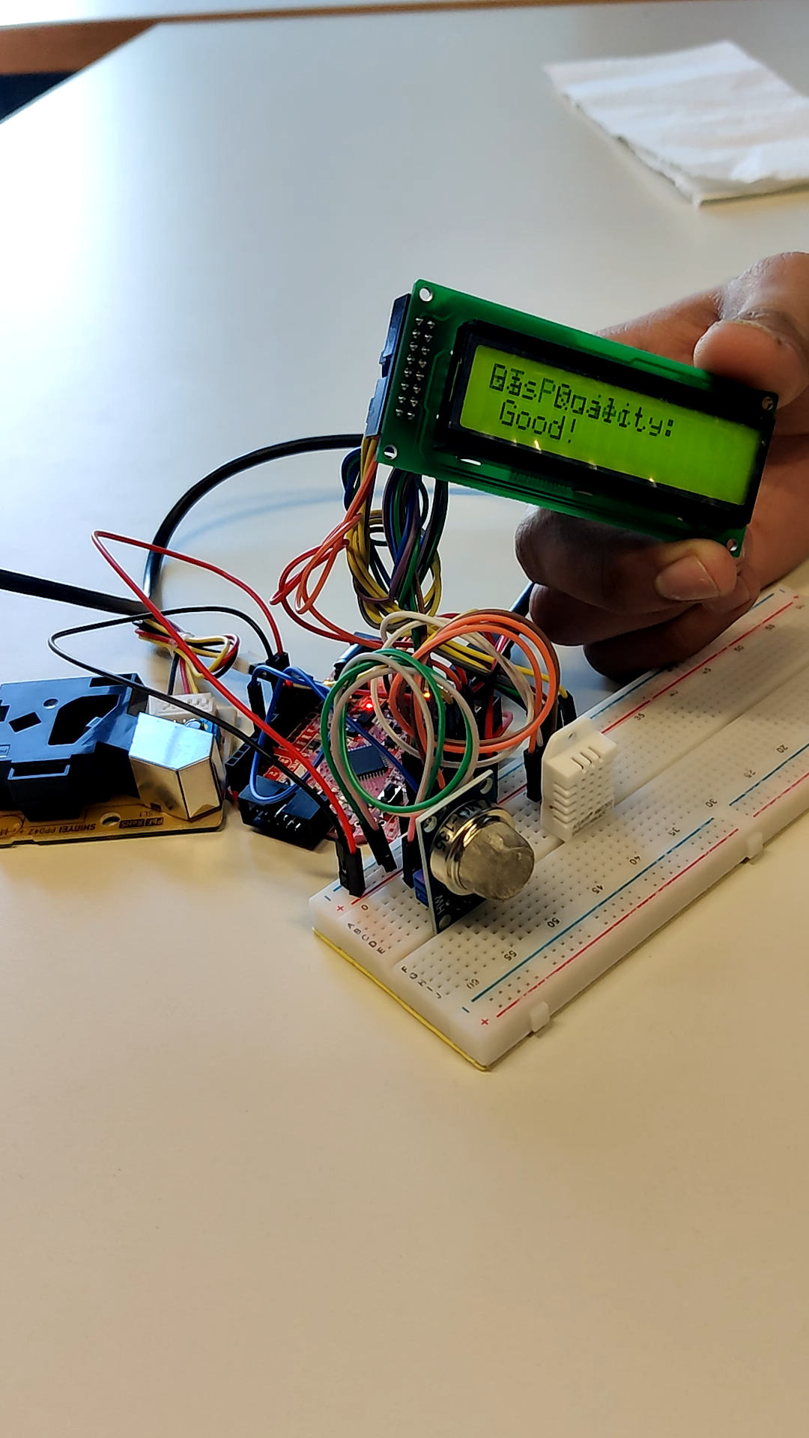
Implementation
Notes:
-This is implement of our project,
you can see how detect a visibility of gas quantity around the particular area.
-you can see how much amount of dust in the air. Which is good or bad for the environment
-It can shows you temperature of current weather.
-In the gas quality sensor we already fix a minimum to maximum range. which is indicate as good, bad and danger
for the particular area, where we want to use it.
-so yea this is our implantation.

Slide 15
Thank you
Thank you

